Slide 1
Department name:
Author’s name:
Date:
Security Level:

Slide 3
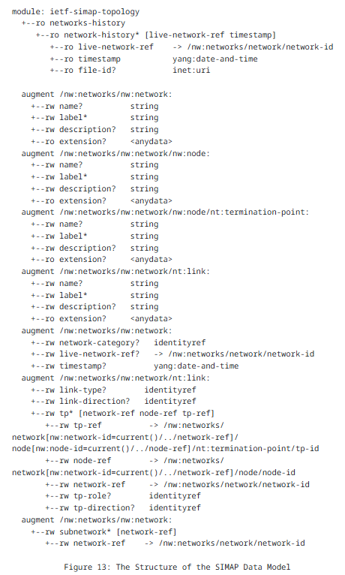
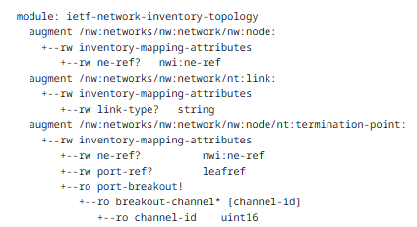
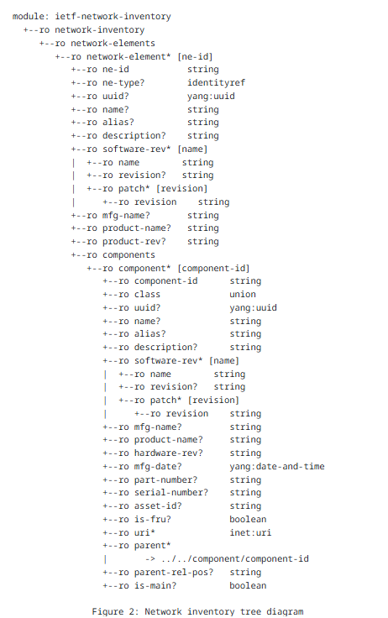
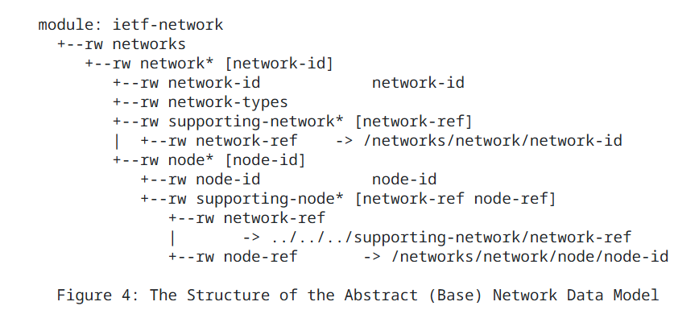
SIMAP and Active and Passive Inventory
draft-havel-nmop-simap-yang-01
draft-ietf-ivy-network-inventory-topology
draft-ietf-ivy-network-inventory-yang
rfc8345
draft-ygb-ivy-passive-network-inventory
Added in ontology
module: ietf-nwi-passive-inventory
augment /nwi:network-inventory:
+--rw cable* [id]
……….
………..
| +--rw component-ref? leafref
+--rw passive-device* [id]
+--rw id string
+--ro uuid? yang:uuid
+--rw name? string
+--rw description? string
+--rw alias? string
+--rw device-type? identityref
+--rw custom-tags* string
+--rw location-ref? nil:ni-location-ref
+--rw passive-port* [id]
+--rw id string
+--ro uuid? yang:uuid
+--rw name? string
+--rw description? string
+--rw alias? string
+--rw port-type? identityref
+--rw fiber-core-num? uint32
Figure 3: Tree diagram for passive network inventory

Slide 4
 | T-Mobile | Huawei | Orange | China Mobile | China Telecom | China Unicom
22M-40M | • | • | • |  |  | •
50M-80M | • | • | • |  |  | •
18M-25M | • | • | • | • |  | •
22M-35M | • | • | • | • |  | •
This page is an illustration of how to apply the color plate. Please delete it before presenting.

